Slide 1
Low Power Protocol and Application Design (II)
Week 14

Slide 2
Power Control and Management of GSM and 3G
GSM Power Control
  Channel measurement
    modes
      Idle mode
      speech mode
    Received signal level (RXLEV) in terms of dBm
    Received signal quality (RXQUAL) in terms of BER
    BCCH : broadcast channel
    TCH : Traffic channel

Slide 3
Power Control and Management of GSM and 3G (Cont.)
Channel measurement (idle mode)
List of BCCH carriers ?
YES
NO
Measure RXLEVs of BCCHs
(36 BCCHs can be stored in SIM at most)
Scan RXLEVs of 124 GSM900 carriers
Cell selection (Max. RXLEV)
Read system (BCCH) and paging information (PCH)
*BTS transmitter power of the BCCH is a constant

Slide 4
Power Control and Management of GSM and 3G (Cont.)
Channel measurement (speech mode)
Measurement current channel (TCH or SDCCH)
BCCH carriers in neighboring BTSs (stored in BCCH Allocation)
Average RXLEV and RXQUAL over a SACCH interval (480 ms)
Send measure report/info to base stations
Handover or power control ?

Slide 5
Power Control and Management of GSM and 3G (Cont.)
GSM Power Control
  Purpose
    minimize co-channel interference
    conserve power
  Power classes
    GSM 900 : 43dBm(20W), 39dBm(8W), 37dBm(5W), 33dBm(2W), 29dBm(0.8)
  Power level
    Increase/decrease in steps of 2dBm
  Threshold

Slide 6
Power Control and Management of GSM and 3G (Cont.)
GSM Power Control (Cont.)
  Threshold
Threshold Parameter | Meaning
L_RXLEV_UL_P L_RXLEV_DL_P L_RXQUAL_UL_P L_RXQUAL_DL_P | Threshold for raising of transmission power in uplink or downlink
U_RXLEV_UL_P U_RXLEV_DL_P U_RXQUAL_UL_P U_RXQUAL_DL_P | Threshold for reducing of transmission power in uplink or downlink

Slide 7


Power Control and Management of GSM and 3G (Cont.)
GSM Power Control (Cont.)
UL thresholds
Measure UL_X
Measurement report (DL_RXLEV, DL_RXQUAL, RXLEV of BCCHs)
DL thresholds

Slide 8
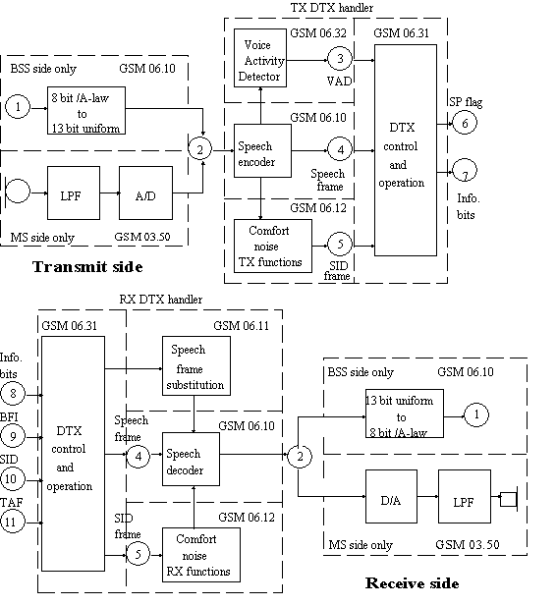
Power Control and Management of GSM and 3G (Cont.)
GSM Power Management
  Discontinuous Transmission (DTX)
    40% voice active
    Save transmission power

Slide 9
Power Control and Management of GSM and 3G (Cont.)
GSM Power Management (Cont.)
  Discontinuous Reception (DRX)
    conserve power
  Procedures
    dividing the MSs within a cell into a set of groups
    known locally at both the MS and the BSS
    paging requests to each group are then scheduled and sent at a particular time
      BSS analyses the IMSI in order to derive the page group of the MS involved
    MS can power down for the period when it knows that page requests will not occur
      MS shall interpret all paging requests in its paging group
    Paging_Group=((IMSI mod 1000) mod (BS_CC_CHANS x N)) mod N
    BS_CC_CHANS=the number of basic physical channels supporting common control channels (CCCHs)
    N=number of paging blocks “available” on one CCCH = (number of paging blocks "available" in a 51 frame TDMA multiframe on one CCCH) x BS_PA_MFRMS.

Slide 10
Power Control and Management of GSM and 3G (Cont.)
3GPP/WCDMA
  GSM multiple access (TDMA+FDMA)
Frequency
Time

Slide 11
Power Control and Management of GSM and 3G (Cont.)
WCDMA (CDMA)
Data 1
Data 2
X-OR
X-OR
Code 1
Code 2
Spread Data 1
Spread Data 2
Combined Signal

Slide 12
Power Control and Management of GSM and 3G (Cont.)
WCDMA (CDMA)
Combined Signal
X-OR
Code 1
De-spread
Data 1

Slide 13
Power Control and Management of GSM and 3G (Cont.)
WCDMA Power Control
  Purpose
    Resolve near-far problem
    Reduce intra-cell interference
    Save UE power
Power 1
Power 2
D1
D2
UE 1
UE 2
Near-far problem

Slide 14

Power Control and Management of GSM and 3G (Cont.)
WCDMA Power Control
UE
Node-B
RNC
Open Loop
Open Loop Power Control
Inner Loop (fast) Power Control
Closed Loop
Outer Loop Power Control

Slide 15
Power Control and Management of GSM and 3G (Cont.)
WCDMA Power Control
  Open loop power control
    Normally used for uplink power adjusting
    UE adjusts its transmission power based on an estimate of the received signal level from BS CPICH
  Close loop power control
    Inner loop (fast)
      At a cycle of 1.5Mhz
      Increase/decrease by 1, 2, 3 dB step
      Based on the received SIR estimated by the BS/UE
      Send transmission power control (TPC) commands to BS/UE
      Both in uplink/downlink
    Outer loop
      Keep the target SIR for the uplink inner loop control

Slide 16
Power Control and Management of GSM and 3G (Cont.)
Power management
  DTX
  DRX
PICH
Paging Indicators
S-CCPCH
Paging Message
7680 chips

Slide 17
Power Control and Management of WLAN
802.11x Power Control
  w/o transmission power control (TPC)
    Purpose
      Improve the transmission quality
    Procedures
      AP/MS power levels (Tx) can be set
      Antenna output power < 1W
      Effective radiated power < 4W
  w/ TPC
    Purpose
      In-band interference mitigation
      Frequency reuse
      Power saving
    In progress

Slide 18
802.11 MAC Basics
Network association procedures
  Scan
  Join
  Authentication
  Association
Access procedures
  DCF mode
  PCF mode
Power saving procedures (Infrastructure mode)
Power saving procedures (Ad hoc mode)

Slide 19



802.11 MAC Basics (Cont.)
802.11 STA
802.11 AP
SCAN start
Scan type ?
beacon
Response
ProbeReq
Active scan
Passive scan
Send
ProbeReq
Expire or receive
beacon?
Receive
Expire
>MinChannelTime or
Receive 1st ProbeResp ?
Receive beacon
Next channel
Receive
ProbeResp
>MinChannelTime
No
<MaxChannelTime
Scan next channel or end of scan
SCAN end

Slide 20
802.11 MAC Basics (Cont.)
802.11 STA
JOIN start
SCAN report
Join decision
(implementation issue)
For example,
SSID=sta.SSID, BSSType=sta.BSSType, RSSI
For example,
Match PHY parameters, timer sync
JOIN end

Slide 21
802.11 MAC Basics (Cont.)
802.11 STA
802.11 AP
AUTH start
Privacy bit ?
0
1
Open system
Shared Key
1. From source(ID) authentication algo=0, seq num=1
2. Authentication algo=0, seq num=2, status code
AUTH end

Slide 22
802.11 MAC Basics (Cont.)
802.11 STA
802.11 AP
AUTH start
Privacy bit ?
0
1
Open system
Shared Key
1. From source(ID) authentication algo=1, seq num=1
2. Auth. algo=1, seq num=2, status code=0, challenge text
3. Auth. Algo=1. seq num=3, challenge text
4. Auth. algo=1, seq num=4, status code=0
AUTH end

Slide 23
802.11 MAC Basics (Cont.)
802.11 STA
802.11 AP
ASSO start
1. Association Req.
2. Association Resp, association ID
Data traffic
ASSO end

Slide 24
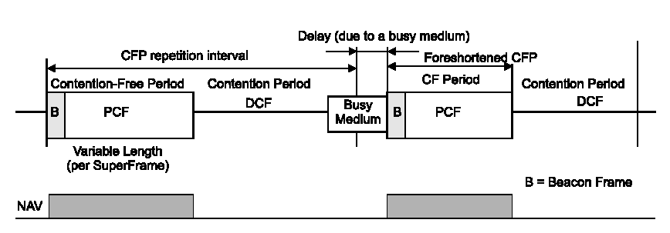
802.11 MAC Basics (Cont.)
DCF
Contention free delivery
Point coordinated function (PCF)
Contention based delivery
Distributed coordinated function (DCF)
Beacon
Contention free
period
Contention period

Slide 25
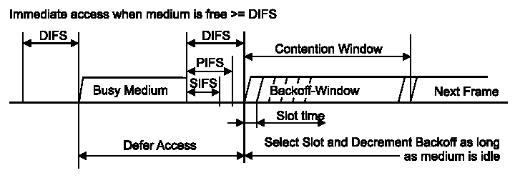
802.11 MAC Basics (Cont.)

Slide 26
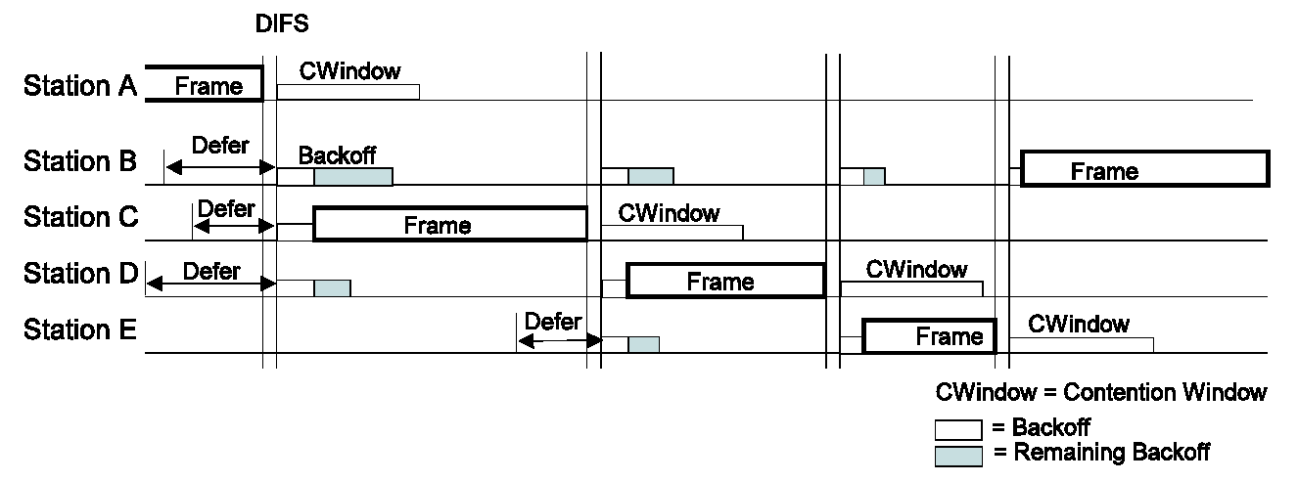
802.11 MAC Basics (Cont.)

Slide 27
802.11 MAC Basics (Cont.)
cw
frame
frame

Slide 28
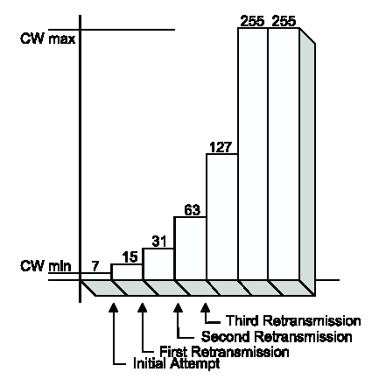
802.11 MAC Basics (Cont.)

Slide 29
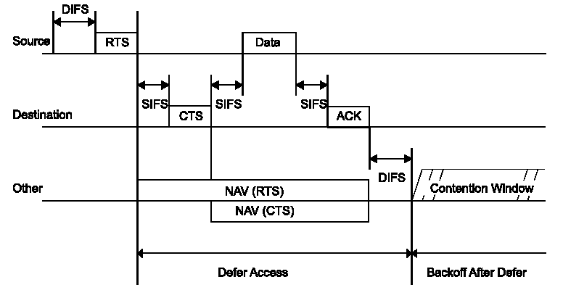
802.11 MAC Basics (Cont.)

Slide 30
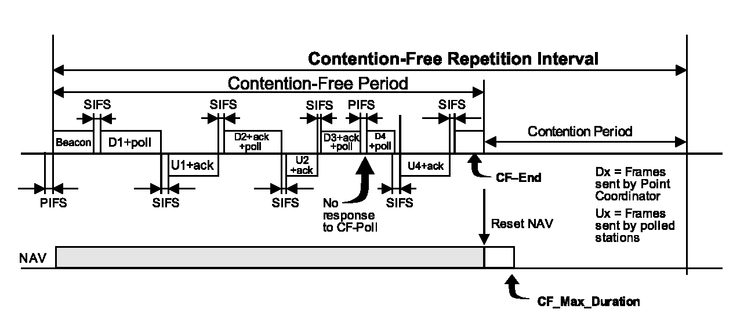
802.11 MAC Basics (Cont.)
PCF

Slide 31
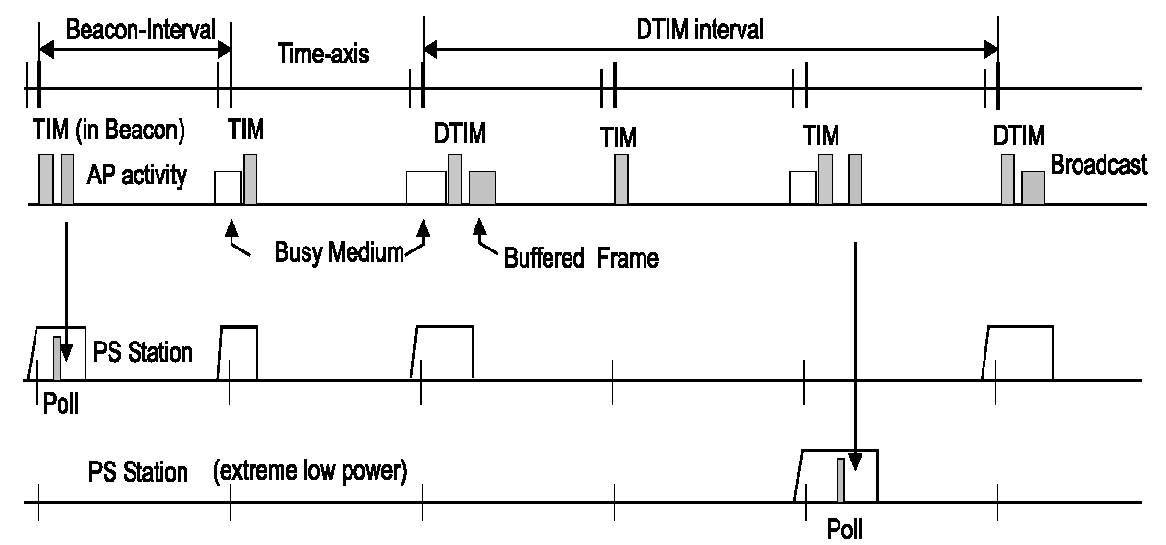
802.11 MAC Basics (Cont.)
Infrastructure PSM

Slide 32
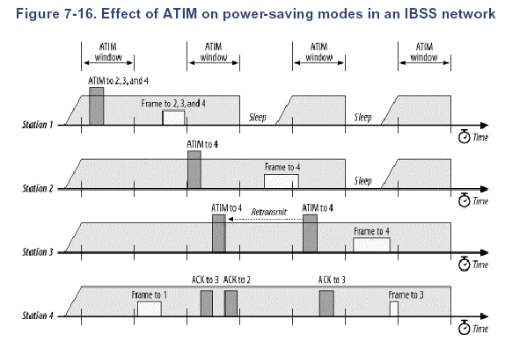
802.11 MAC Basics (Cont.)
IBSS PSM
ACK to 2 and 3

Slide 33
Power Control and Management of WLAN (Cont.)
802.11 Power management
  Infrastructure network (unicast/multicast/broadcast)
  Ad hoc network (unicast/multicast/broadcast)
Beacon Interval
TIM:frame for 1&2
AP
TIM:frame for 1
TIM:frame for 1&2
Time
TIM:frame for 2
Station 1
Time
Station 2
Time
  Infrastructure network (unicast)

Slide 34
Power Control and Management of Bluetooth
Bluetooth
  Power control
    Power class
    Adaptive transmission power
      Slave to inform master when master’s transmission power is no appropriate
        Received signal strength indicator (RSSI)
Power Class
Maximum Output
Power
1
100 mW
(20 dBm)
2
2.5 mW
(4 dBm)
3
1 mW
(0 dBm)

Slide 35
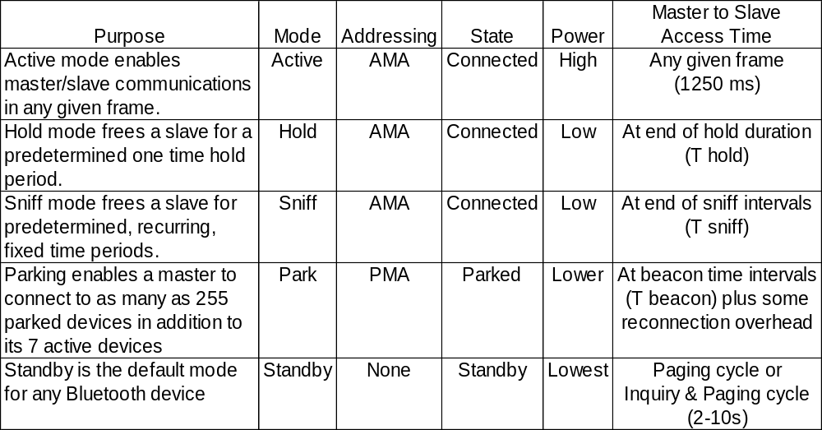
Power Control and Management of Bluetooth (Cont.)
Power management
Connected mode
standby mode
Source : XILINX web site

Slide 36
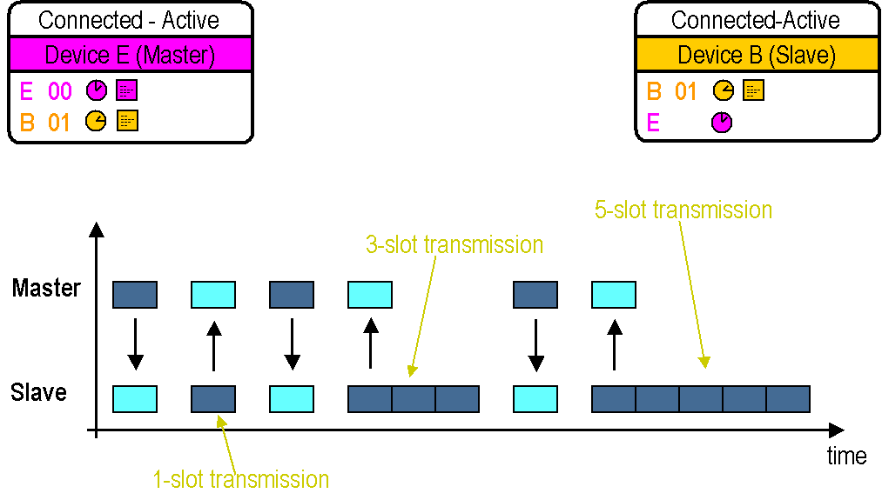
Power Control and Management of Bluetooth (Cont.)
Active mode
  Device actively participates in the channel
    Master allocates transmissions based on demands
  Supports regular transmissions to keep maintain device synchronization
  Limited to 7 devices
Source : XILINX web site

Slide 37
Power Control and Management of Bluetooth (Cont.)
Hold mode
  When Connected, the ACL link to a slave can be put in Hold mode
  Hold mode allows the slave to do other things like scanning, paging, inquiring, attending to other piconets, or simply sleeping
  Before entering Hold mode the master and slave agree on the time duration for the hold period
  A timer is initialized with the Hold timeout value
  The slave returns to the Piconet when the timer expires
  Slave synchronizes to the traffic on the channel
  Slave waits for instructions from the master
Source : XILINX web site

Slide 38
Power Control and Management of Bluetooth (Cont.)
Hold mode (Cont.)
Connected - Active
Connected-Hold
Device E (Master)
Device B (Slave)
E
B
00
01 (AMA)
--
----
---
--
B
E
01
--
----
---
--
--
----
---
--
Slave waits for transmissions
from master
Slave wakes up
Master
Slave
T-hold
time
Source : XILINX web site

Slide 39
Power Control and Management of Bluetooth (Cont.)
Sniff mode
  Sniff mode provides a connected slave a recurring series of free time
  Master can only communicate during specified Sniff time slots
  Sniff mode allows the slave to do other things like scanning, paging, inquiring, attending to other piconets, or simply sleeping
Source : XILINX web site

Slide 40
Power Control and Management of Bluetooth (Cont.)
Connected - Active
Connected-Sniff
Device E (Master)
Device B (Slave)
E
B
00
01
--
----
---
--
B
E
01
--
----
---
--
--
----
---
--
Master
Slave
D-sniff
D-sniff
time
T-sniff
T-sniff
Source : XILINX web site
1 through N

Slide 41
Power Control and Management of Bluetooth (Cont.)
Park mode
  A Parked slave remains synchronized to the Piconet but does not actively participate
  All messages sent to Parked slaves are carried by broadcast packets (the all-zero AMA)
  The Parked slave wakes up at a regular Beacon interval in order to maintain synchronization and to check for broadcast messages
  The Beacon channel supports Piconet access of Parked slaves
  The Beacon period is communicated to the slave when it is being Parked.
  Beacon transmissions can extend over multiple Slots in a Beacon Train
  Beacon Slots must have master-to-slave traffic
  If there is no information to be sent null packets are transmitted by the master
Source : XILINX web site

Slide 42
Power Control and Management of Bluetooth (Cont.)
Park mode
Connected - Active
Connected-Park
Device E (Master)
Device B (Slave)
E
B
00
001 (PMA)
002 (ARA)
--
----
---
--
B
E
01PMA
--
----
---
--
02 ARA
--
----
---
--
Beacon Slots of a Beacon Train
Beacon Slots of a Beacon Train
Master
Slave
time
T-beacon
T-beacon
Active
Parked
Active
Source : XILINX web site

Slide 43
Power Control and Management of Bluetooth (Cont.)
Standby mode
  Standby mode is a predominantly low power state
    Devices in Standby sleep for 1.26 seconds out of every 1.28 seconds
  The only activity typical in Standby mode is Page and Inquiry Scanning
  Inquiry Scanning is a 10 millisecond process that Bluetooth devices execute once every 1.28 seconds to see if another device may be trying to Discover it
    Inquiry Scanning monitors a fixed set of 32 Inquiry frequencies
    Each Inquiry Scan is performed on a single frequency
    Subsequent Inquiry Scans progressively cycle through the 32 frequency subset on a continuous basis
  Page Scanning is a 10 millisecond process that Bluetooth devices execute once every 1.28 seconds to see if another device wants to establish a Connection
    Page Scanning monitors a set of 32 frequencies specific to each device
    Each Page Scan is performed on a single frequency
    Subsequent Page Scans progressively cycle through the 32 frequency subset on a continuous basis

